Slide 1
HW#1
Structure of class assignments
Walking Pattern
Generator
Off-line COM pattern
On-line COM pattern
Analytic method
Jacobian method
QP method
Foot step
Planning
ZMP pattern generation
COM pattern generation
Inverse kinematics
Joint position controller
Actuators
Robot
Foot trajectory generation

Slide 2
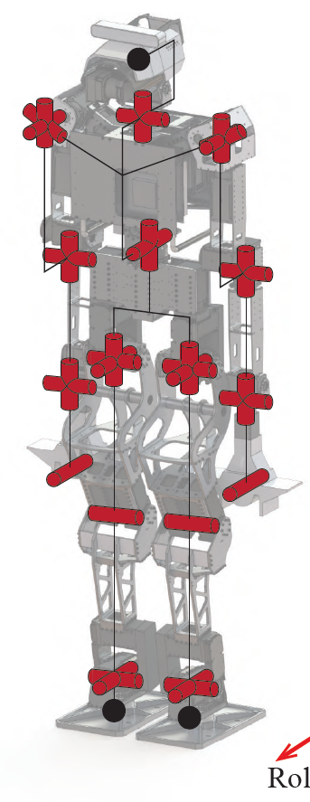






































Kinematics of DYROS-Jet
$$z_{4,5,6}$$
Yaw, Z
Hip yaw
$$q_{4}$$
$$Σ_{w}$$
Pitch, Y
Hip pitch
$$q_{6}$$
Roll, X
Body
$$y_{4,5,6}$$
Hip roll
$$x_{4,5,6}$$
$$q_{5}$$
$$p_{\begin{aligned}10,11 \\ ,12\end{aligned}}$$
$$z_{10,11,12}$$
$$z_{0,3}$$
0.795m
$$p_{0,3}$$
$$L_{1}$$
$$p_{4,5,6}$$
$$x_{10,11,12}$$
$$y_{\begin{aligned}10,11 \\ ,12\end{aligned}}$$
Pelvis
$$y_{0,3}$$
Hip pitch offset
+24.08 deg
0.105m
$$x_{0,3}$$
0.1119m
$$z_{13}$$
$$L_{2}$$
0.3713m
Simplify
$$p_{13}$$
$$z_{7}$$
Knee pitch offset
-14.82 deg
$$x_{13}$$
$$y_{13}$$
$$p_{7}$$
Knee pitch
$$y_{7}$$
$$q_{7}$$
0.8401m
$$x_{7}$$
$$z_{14,15}$$
$$L_{3}$$
0.3728m
$$p_{14,15}$$
$$z_{8,9}$$
Ankle pitch offset
-9.26 deg
$$y_{14,15}$$
$$p_{8,9}$$
$$y_{8,9}$$
$$x_{14,15}$$
Ankle pitch
Yaw, Z
$$x_{8,9}$$
$$q_{8}$$
0.096m
Ankle roll $q_{9}$
Pitch, Y
Roll, X
* Joint offsets exist to align the hips, knees and ankles in a straight line.
Frame 0 → Base frame
Frame 3 → Pelvis frame

Slide 3










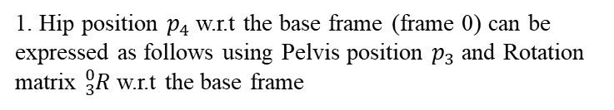





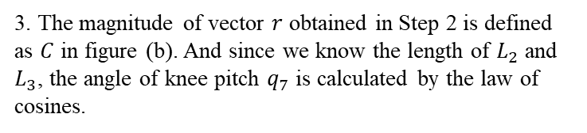












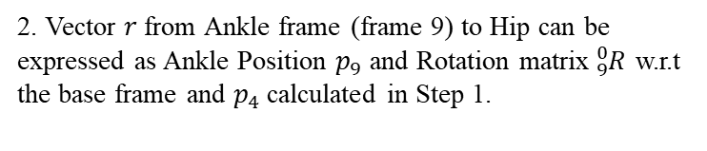

Yaw, Z
Inverse kinematics
$$Σ_{w}$$
Pitch, Y
$$z_{4,5,6}$$
Get the knee joint angle
Roll, X
Hip yaw
$$q_{4}$$
1. Hip position $p_{4}$ w.r.t the base frame (frame 0) can be expressed as follows using Pelvis position $p_{3}$ and Rotation matrix ${}_{3}^{0}R$w.r.t the base frame
Body
Hip pitch
$$q_{6}$$
$$p_{4}=p_{3}+{}_{3}^{0}R\left[\begin{matrix}0 \\ L_{1} \\ 0\end{matrix}\right]$$
$$y_{4,5,6}$$
$$q_{5}$$
$$z_{0,3}$$
Hip roll
2. Vector $r$ from Ankle frame (frame 9) to Hip can be expressed as Ankle Position $p_{9}$ and Rotation matrix${}_{9}^{0}R$ w.r.t the base frame and $p_{4}$ calculated in Step 1.
$$p_{0,3}$$
$$L_{1}$$
$$x_{4,5,6}$$
$$x_{0,3}$$
$$y_{0,3}$$
$$p_{4,5,6}$$
$$r={({}_{9}^{0}R)}_{ }^{T}\left(p_{4}−p_{9}\right)=\left[\begin{matrix}r_{x} \\ r_{y} \\ r_{z}\end{matrix}\right]$$
$$L_{2}$$
$$L_{2}$$
3. The magnitude of vector $r$ obtained in Step 2 is defined as $C$ in figure (b). And since we know the length of $L_{2}$ and $L_{3}$, the angle of knee pitch $q_{7}$ is calculated by the law of cosines.
$$q_{7}$$
$$r$$
C
$$p_{7}$$
$${π−q}_{7}$$
$$L_{3}$$
$$p_{8,9}$$
$$q_{7}$$
$$C=\sqrt{r_{x}^{2}+r_{y}^{2}+r_{z}^{2}},C^{2}=L_{2}^{2}+L_{3}^{2}−2L_{2}L_{3}cos\left(π−q_{7}\right)$$
$$α$$
$$L_{3}$$
$$q_{8}$$
$$q_{9}$$
4. In Figure (b), 𝛼 is calculated by the law of sines.
Foot
$$\frac{C}{\sin\left(π−q_{7}\right) }=\frac{L_{2}}{\sin\left(α\right)}$$
(a) Definition
(b) Get the knee angle

Slide 4


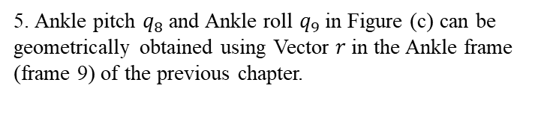

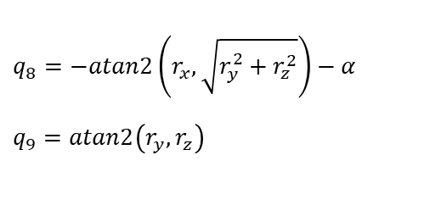




Yaw, Z
Inverse kinematics
$$Σ_{w}$$
Pitch, Y
$$z_{4,5,6}$$
Get the ankle joint angle
Roll, X
Hip yaw
$$q_{4}$$
5. Ankle pitch $q_{8}$and Ankle roll $q_{9}$in Figure (c) can be geometrically obtained using Vector $r$ in the Ankle frame (frame 9) of the previous chapter.
Body
Hip pitch
$$q_{6}$$
$$y_{4,5,6}$$
$q_{8}=−atan2\left(r_{x},\sqrt{r_{y}^{2}+r_{z}^{2}}\right)−α$
$q_{9}=atan2\left(r_{y}, r_{z}\right)$
$$q_{5}$$
$$z_{0,3}$$
Hip roll
$$p_{0,3}$$
$$L_{1}$$
$$x_{4,5,6}$$
$$x_{0,3}$$
$$y_{0,3}$$
$$r_{x}$$
$$r_{y}$$
$$p_{4,5,6}$$
$$q_{9}$$
$$L_{2}$$
$$q_{7}$$
$$r$$
$$p_{7}$$
$$r$$
$$r_{z}$$
$$L_{3}$$
$$q_{8}$$
$$p_{8,9}$$
$$α$$
$$q_{8}$$
$$q_{9}$$
Foot
Foot
(a) Definition
(c) Get the ankle angles

Slide 5
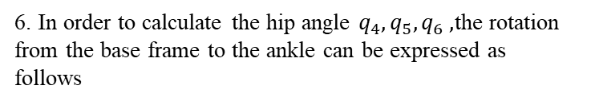



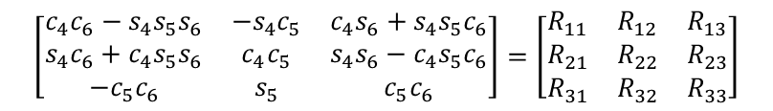
Yaw, Z
Inverse kinematics
$$Σ_{w}$$
Pitch, Y
$$z_{4,5,6}$$
Get the hip joint angle
Roll, X
Hip yaw
$$q_{4}$$
6. In order to calculate the hip angle $q_{4}, q_{5}, q_{6} ,$the rotation from the base frame to the ankle can be expressed as follows
Body
Hip pitch
$$q_{6}$$
$$y_{4,5,6}$$
$${}_{9}^{0}R=({}_{3}^{0}R)R_{z}\left(q_{4}\right)R_{x}\left(q_{5}\right)R_{y}\left(q_{6}\right)R_{y}\left(q_{7}+q_{8}\right)R_{x}\left(q_{9}\right)$$
$$q_{5}$$
$$z_{0,3}$$
Hip roll
$$p_{0,3}$$
$$L_{1}$$
$$x_{4,5,6}$$
$$R_{z}\left(q_{4}\right)R_{x}\left(q_{5}\right)R_{y}\left(q_{6}\right)={\left({}_{3}^{0}R\right)}^{T}({}_{9}^{0}R)R_{x}{\left(q_{9}\right)}^{T}R_{y}{\left(q_{7}+q_{8}\right)}^{T}$$
$$x_{0,3}$$
$$y_{0,3}$$
$$p_{4,5,6}$$
$$L_{2}$$
7. Calculate hip joint angle using knee roll, ankle roll, pitch angle and rotation matrix of Pelvis and Ankle w.r.t the base frame
$$q_{7}$$
$$r$$
$$p_{7}$$
$$\left[\begin{matrix}c_{4}c_{6}−s_{4}s_{5}s_{6} & −s_{4}c_{5} & c_{4}s_{6}+s_{4}s_{5}c_{6} \\ s_{4}c_{6}+c_{4}s_{5}s_{6} & c_{4}c_{5} & s_{4}s_{6}−c_{4}s_{5}c_{6} \\ −c_{5}c_{6} & s_{5} & c_{5}c_{6}\end{matrix}\right]=\left[\begin{matrix}R_{11} & R_{12} & R_{13} \\ R_{21} & R_{22} & R_{23} \\ R_{31} & R_{32} & R_{33}\end{matrix}\right]$$
$$L_{3}$$
$$p_{8,9}$$
$q_{4}=atan2\left(−R_{12},R_{22}\right)$
$$q_{8}$$
$$q_{9}$$
$q_{5}=atan2(R_{32},−R_{12}s_{4}+R_{22}c_{4})$
Foot
$$q_{6}=atan2(−R_{31},R_{33})$$
(a) Definition

Slide 6
Inverse kinematics
Body
Body
1. In the inverse kinematic calculations performed in the previous chapters, the zero configuration of the robot was shown in Figure a.
2. As shown in Figure b, the zero configuration of Dyros-Jet is different from the zero configuration of a.
3. To make the zero configuration equal to figure a, you need to add the offset of Hip (24.08 deg), Knee (-14.82 deg), and Ankle (-9.26 deg).
(a) Zero configuration of a simplified humanoid robot
(b) Zero configuration of Dyros-jet

Slide 7
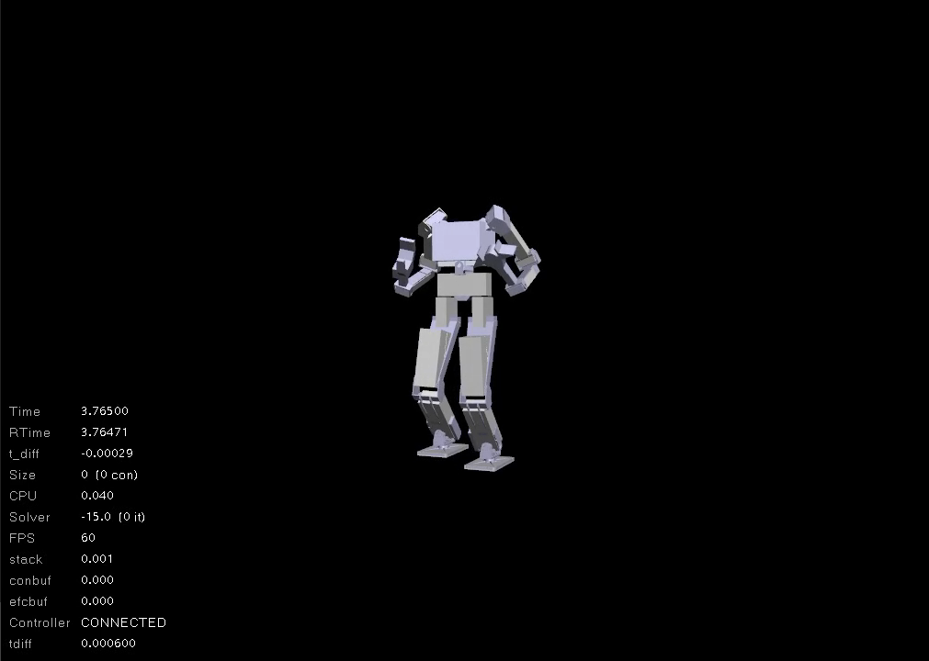
HW#1 simulation video

